Slide 1
Secure data hiding in images using steganography
CAPSTONE PROJECT
Presented By: Digvijay Sadashiv Patil.
Student Name : Digvijay Sadashiv Patil.
College Name & Department : Konkan Gyanpeeth College of Engineering, Karjat. Information Technology.

Slide 2
OUTLINE
Problem Statement
Technology used
Wow factor
End users
Result
Conclusion
Git-hub Link
Future scope

Slide 3
Problem Statement
The project aims to develop a Steganography Application using Python that allows users to hide secret messages within images (encryption) and retrieve them later (decryption).
The application provides a user-friendly graphical interface built with Tkinter, enabling users to interact with the program easily.
The program uses OpenCV for image processing and PIL for displaying image previews. The challenge lies in implementing a secure and efficient method to encode and decode messages within image files while maintaining the image's visual integrity.

Slide 4
Technology used
Python Libraries:
OpenCV (cv2): For image processing, such as reading and modifying pixel values.
Tkinter: To create the graphical user interface (GUI) with tabs, buttons, and text boxes.
PIL (Pillow): For displaying image previews in the GUI.
Concepts:
Steganography: The art of hiding information within digital media.
ASCII Encoding: Converting text messages into numerical values for embedding into image pixels.

Slide 5
Wow factors
User-Friendly Interface: The application provides a simple and intuitive GUI with separate tabs for encryption and decryption, making it accessible even to non-technical users.
Secure Message Hiding: The program uses a password-based approach to ensure that only authorized users can retrieve the hidden message.
Image Integrity: The encryption process modifies pixel values subtly, ensuring the image looks unchanged to the human eye.
Cross-Platform Compatibility: Built with Python, the application can run on Windows, macOS, and Linux systems

Slide 6
End users
General Users: Individuals who want to securely share confidential messages or data.
Organizations: Companies that need to embed sensitive information in images for secure communication.
Students and Educators: Those learning about steganography, image processing, or GUI development in Python.

Slide 7
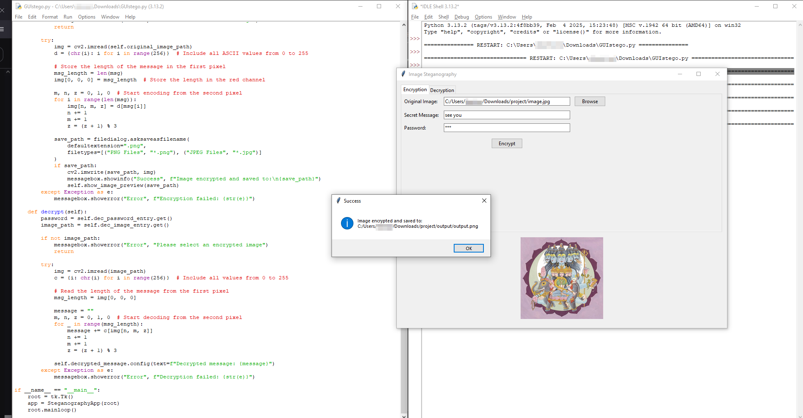
Results
The program successfully allows users to: Encrypt Messages: Hide a text message within an image file by modifying its pixel values.
Decrypt Messages: Retrieve the hidden message from the modified image using the correct password.
Preview Images: Display the selected image in the GUI for verification before and after encryption.
The output is a new image file with the hidden message embedded, which can be shared securely.

Slide 8
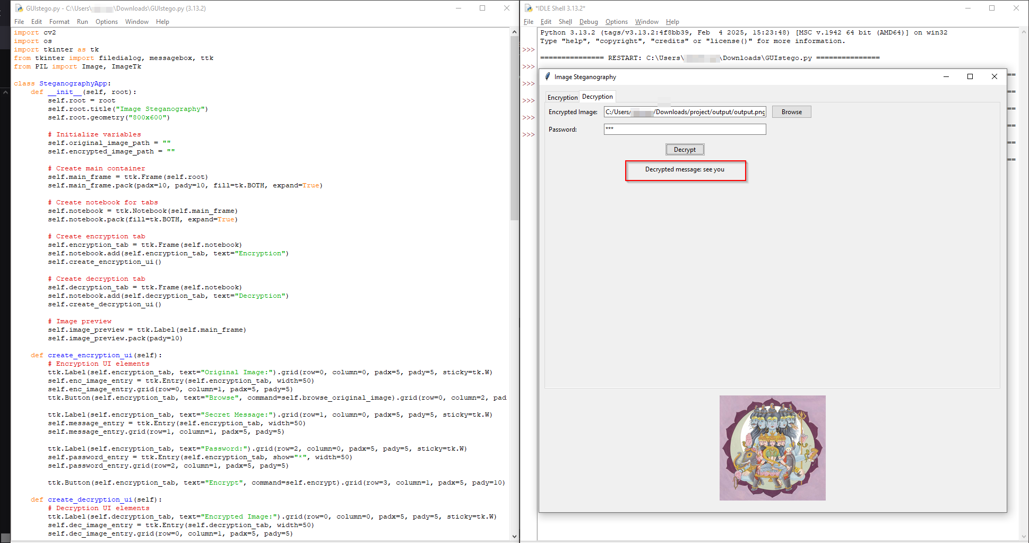

Slide 9
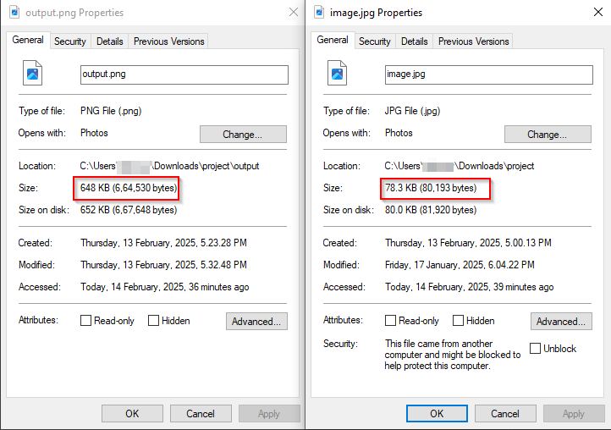

Slide 10
Conclusion
This project demonstrates the practical application of steganography in a user-friendly Python program.
By combining image processing with GUI development, the application provides a secure and accessible way to hide and retrieve messages within images.
The use of OpenCV, Tkinter, and PIL showcases the versatility of Python in solving real-world problems.

Slide 11
GitHub Link
https://github.com/patil-digvijay/aicte-project.git

Slide 12
Future scope
Advanced Encryption: Implement stronger encryption algorithms to enhance security.
Support for Other Media: Extend the application to hide messages in audio or video files.
Mobile Application: Develop a mobile version of the application for Android and iOS platforms.
Cloud Integration: Add cloud storage options for saving and sharing encrypted images securely.
Error Detection: Include mechanisms to detect and handle errors during encryption or decryption.
This project has the potential to evolve into a robust tool for secure communication and data hiding.

Slide 13
THANK YOU

